Slide 1
Software Requirements Specification Document(SRS)

Slide 2
Software Requirements Specification Document(SRS)
SRS is a document that mentioned complete description about
how the system is expected to perform.
Behaviour of the system.
Functional and non functional requirements of the system.

Slide 3
Users of SRS
Client
Development Team
Maintenance Team
Technical Writers

Slide 4
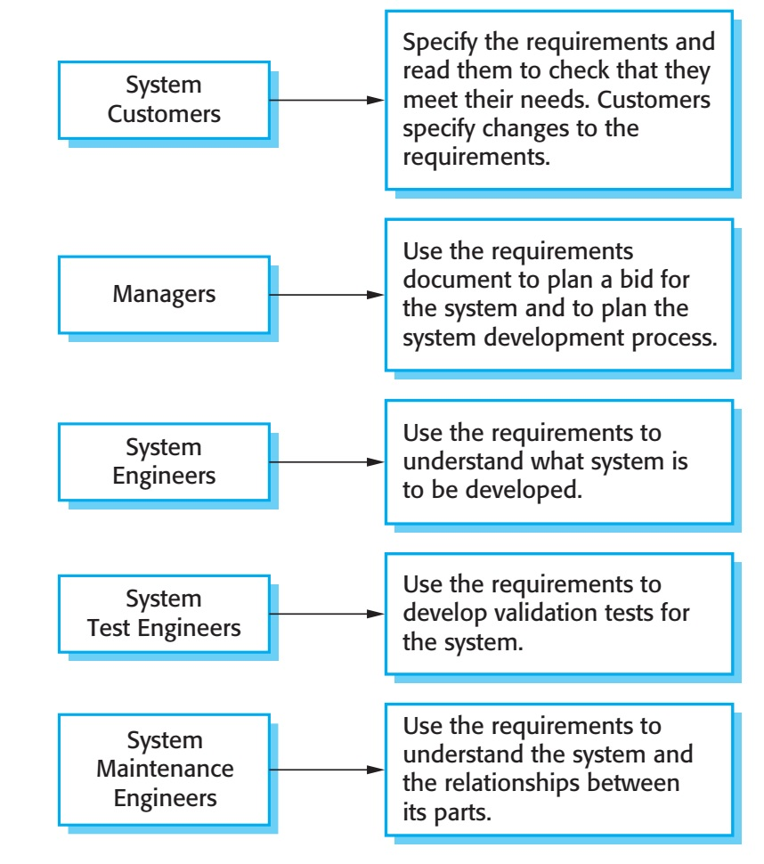
Users of RequirementsDocument

Slide 5
Need of SRS Document
It structures and formalizes all project requirements.
Exactly meets the customer Requirements.
Minimizes the possible misunderstandings.
Necessary information while working on a project.
Plan particular iterations and release dates.
Estimates the required development budget.

Slide 6
Structure of SRS
1.Introduction 1.1 purpose 1.2 Intended Audience 1.3 scope 1.4 Definition 1.5 References | 2.Overall Description 2.1 User Interface 2.2 System Interface 2.3 software and Hardware Requirements 2.4 constraints 2.5 User Characteristics
3. System Features and Requirements 3.1 Functional Reqiurements. 3.2 Usecase and sequence diagrams. 3.3 External interface Requirements. 3.4 Database Requirements. 3.5Non Functional Requirements. | 4.Deliver for Approval

Slide 7
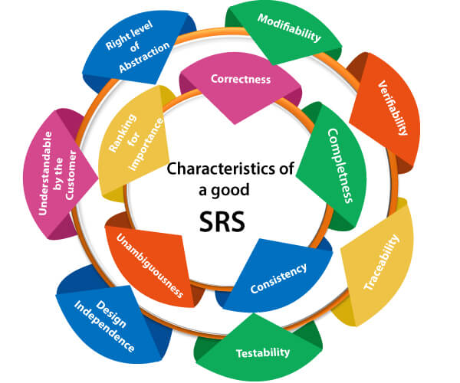
Characteristics of Good SRS Document

